Slide 1
Word List: junct, join, jug
to join, meet, or link

Slide 2
joined; united together; combined

Slide 3
conjoined
joined; united together; combined

Slide 4
to join together or match a correct verb in grammar

Slide 5
conjugate
to join together or match a correct verb in grammar

Slide 6
a word that joins two phrases or sentences

Slide 7
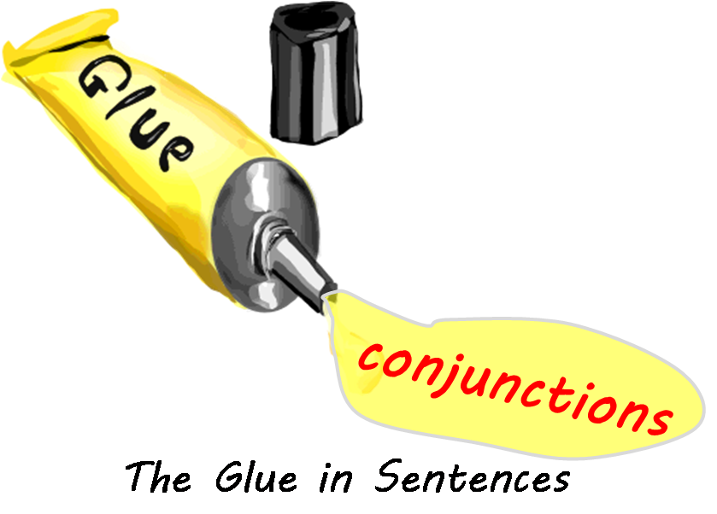
conjunction a word that joins two phrases or sentences

Slide 8
not connected; having no flow in thinking

Slide 9
disjointed
not connected; having no flow in thinking

Slide 10
to get together or meet; to become included

Slide 11
join
to get together or meet; to become included

Slide 12
a place or part of the body where two bones join together, usually so they can move

Slide 13
joint
a place or part of the body where two bones join together, usually so they can move

Slide 14
a committee with members from both the Senate and the House of Representatives who join together and meet to discuss issues

Slide 15
joint committee
a committee with members from both the Senate and the House of Representatives who join together and meet to discuss issues

Slide 16
a vein that carries blood back to the heart from the head; a vein that joins the head and the heart

Slide 17
jugular
a vein that carries blood back to the heart from the head; a vein that joins the head and the heart

Slide 18
the place where two highways or two sets of railroad tracks cross or join

Slide 19
to meet or get together again

Slide 20
rejoin
to meet or get together again

Slide 21
END!

